Slide 1


Tool Depot
Creator: Tyon Davis

Slide 2

Supplier for Tool Depot
Determine the most cost-effective supplier (A or B) to provide hammers for Tool Depot for the next year, considering product costs, shipping costs, and expected order growth.

Slide 3

Key Information
Hammer Orders:
Expected to mirror wrench orders.
Orders projected to grow 10% annually.
Shipping Details:
Cheapest carrier (X or Y) is selected per week for each supplier’s origin-destination pair.
Maximum shipment capacity: 44,000 lbs per load.
Hammer Cost:
Supplier A: $0.80/unit.
Supplier B: $0.82/unit.

Slide 4
Hammer Production Cost Formula
= ((Wrenches_Total_Order_Quantity *.10) + Wrenches_Total_Order_Quantity)* Hammer_Weight) * (Supplier_hammer_cost))

Slide 5
Carrier X Formula
= (((((Order_Quantity_Total * .10) +Order_Quantity_Total )*Product_Information_Weight)/ Max_Pounds_Per_Shipment)*Carrier.Cost)

Slide 6
Carrier Y Formula
= ((((Order_Quantity_Total * .10) +Order_Quantity_Total )*Product_Information_Weight)*Carrier.Cost)

Slide 7

Transportation Cost Formula
=min( Carrier_X_Formula or Carrier_Y_Formula) + n for everyshipment
Where n is min( Carrier_X_Formula or Carrier_Y_Formula)

Slide 8

Total Cost Formula
==((Hammer Production Cost Formula) + (Hammer_Transportation Cost Formula))

Slide 9
Excel
Data Cleaning Steps:
Removed spaces from header names for compatibility with SQLite.
Reformatted dates from DD/MM/YYYY to YYYY-MM-DD.
Exported the cleaned dataset to a CSV file for SQL-based analysis.

Slide 10
SQLite
Database Creation:
Created ten new tables to store key data.
Linked key relationships in the data.
Wrote queries that Implemented the formulas from earlier slides to calculate total costs and shipping metrics.
Exported the processed data into a JSON file.
Imported the JSON file into Tableau for advanced visualization and analysis.

Slide 11
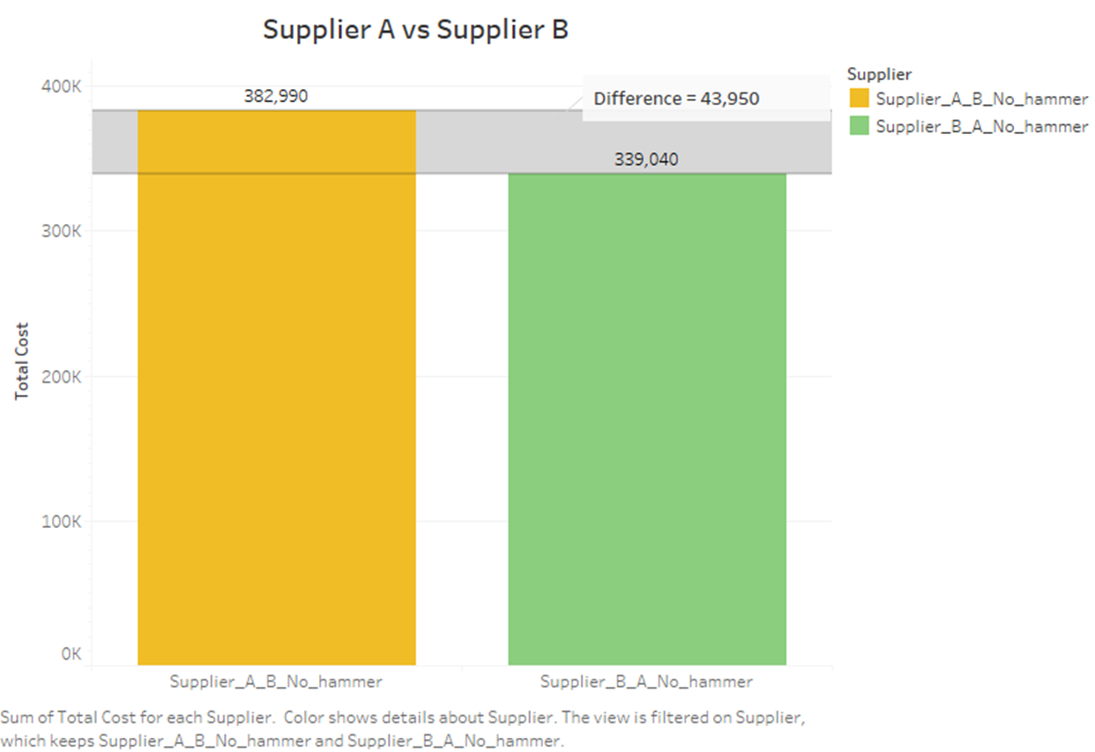

Slide 12
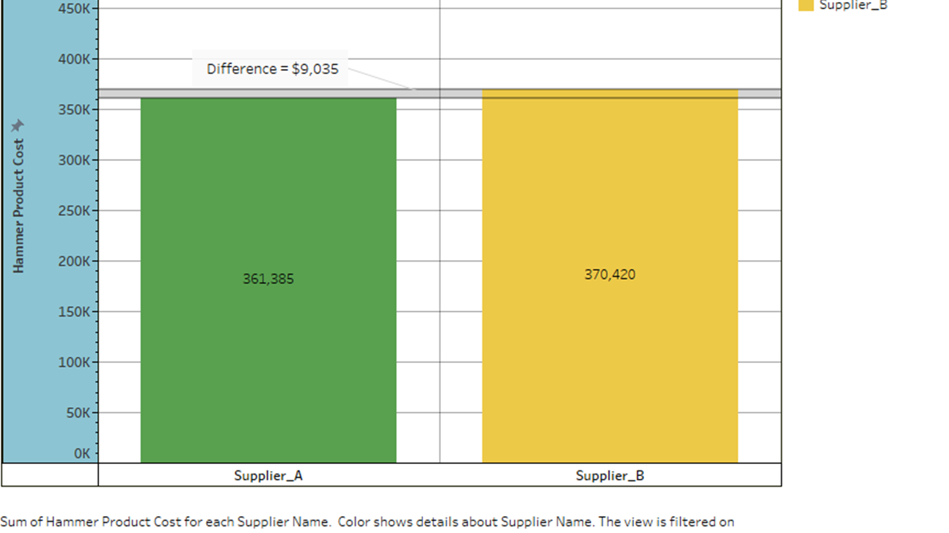

Slide 13
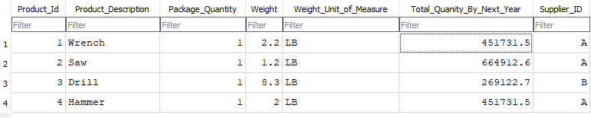

Slide 14
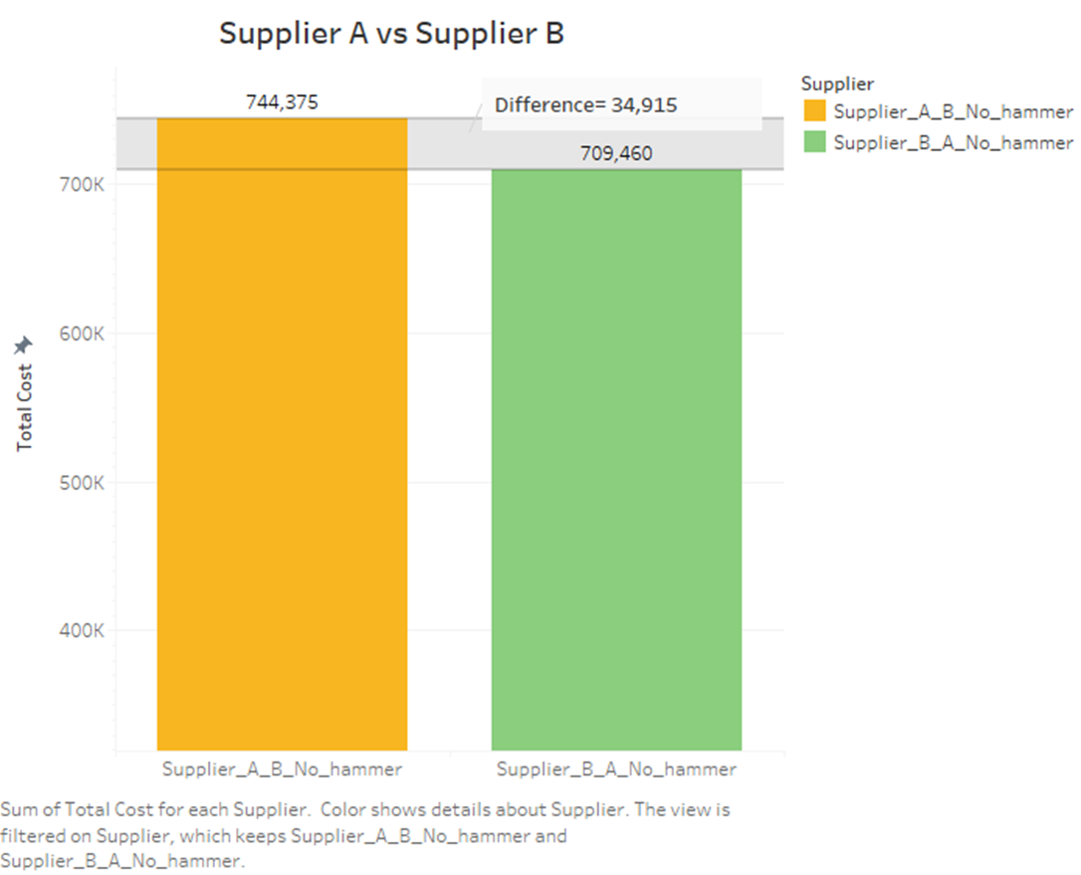

Slide 15
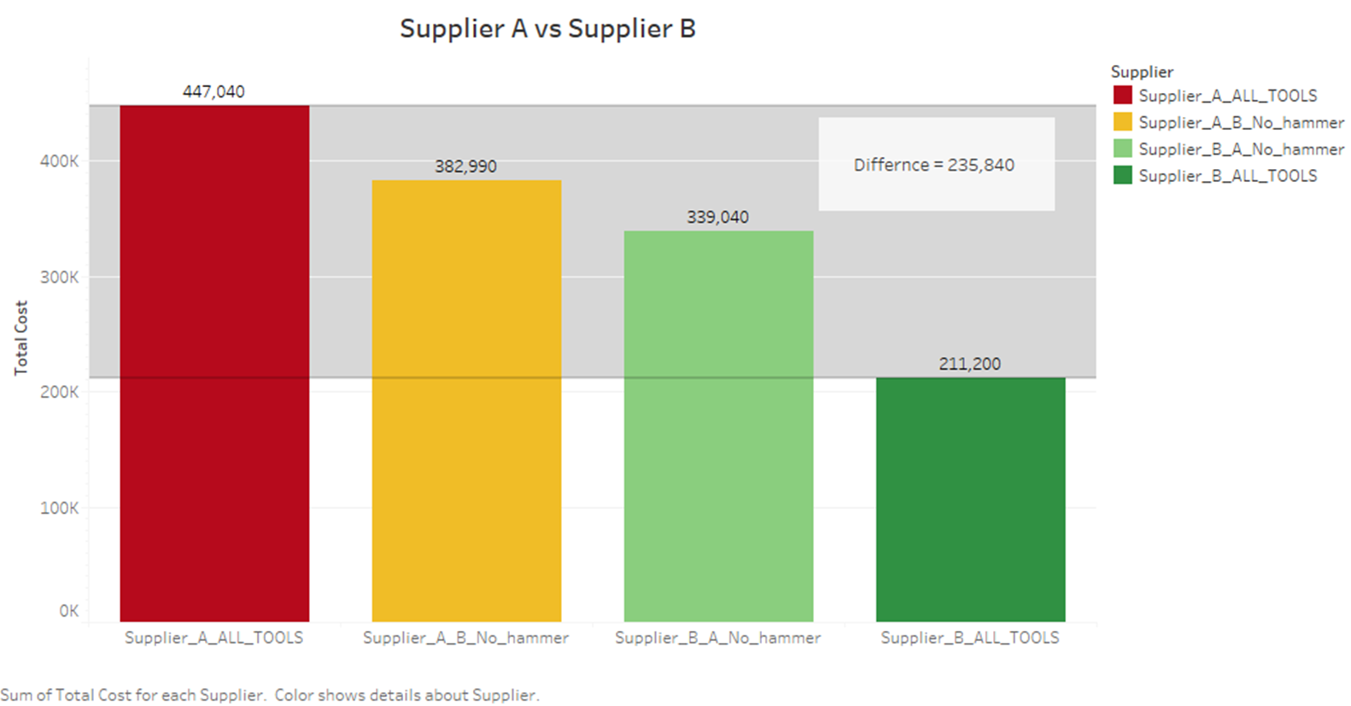

Slide 16
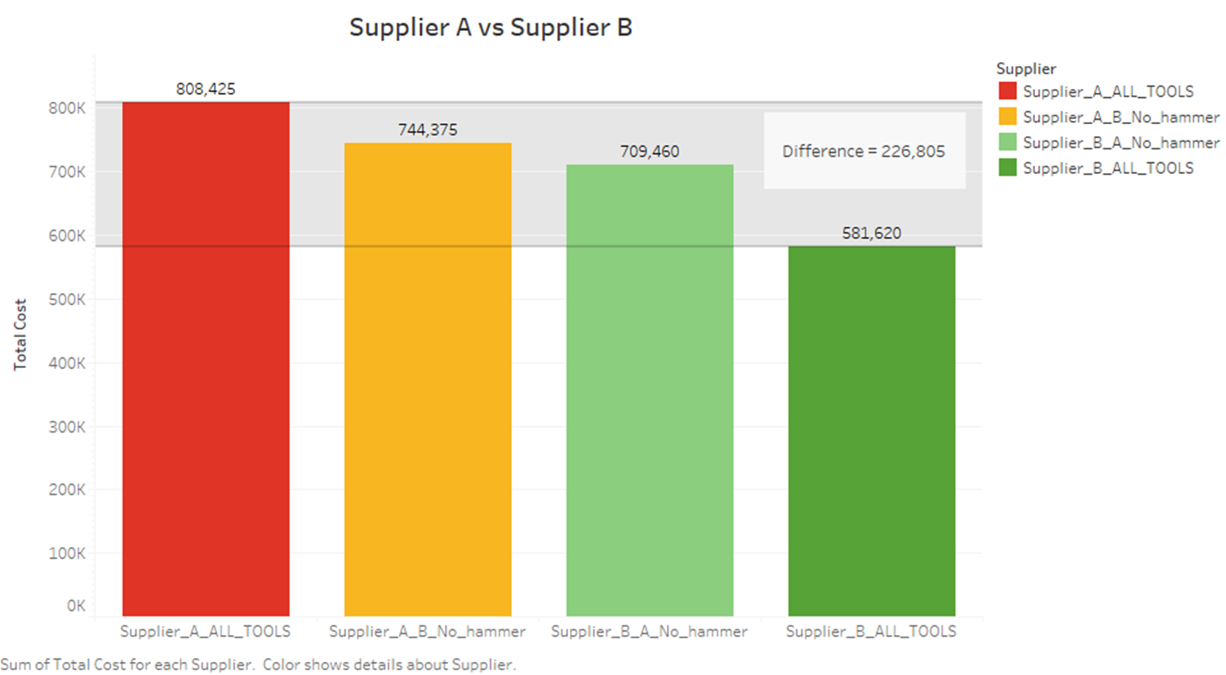

Slide 17
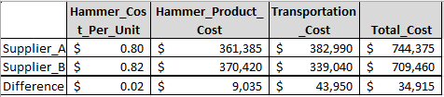
Excel Answers

Slide 18

Results
Supplier A offers a lower hammer unit cost, Supplier B is the better choice overall due to significantly lower transportation costs, resulting in a total cost savings of $34,915. This makes Supplier B more cost-effective.

Slide 19
Key Insights
Currently, the costs for wrenches, saws, and drills remain unknown. This uncertainty could impact the data and could potentially make Supplier A more favorable option in the future. However, based on the current information, I strongly recommend prioritizing Supplier B, given the limited number of tools we are selling at this time.

